Slide 1
SEL Blueframe Python SDK
Sprint 4 | Go Wrapper for Python SDK
Caleb Hansen, Genevieve Kochel, Darron Li, Lucas Phillips
CptS 423 | Team 03-SEL-BFSDK | Client Joe Stanley, SEL | September 2026
Notes:
Presenter: Lucas Phillips
Open the video. Say the project name, the course, and that this is the Sprint 4 walkthrough. Mention that we will go round robin, so each section is presented by a different person.

Slide 2
1
Introduction
Project, team roles, and what Sprint 4 set out to do
The project
Blueframe apps move real-time grid data through Signal Hub. SEL has clients for it in Go and C#, but most automation engineers work in Python.
We are building a Python SDK that wraps an existing client instead of porting it, so SEL does not end up maintaining a third copy.
Sprint 4 goal
Answer the client's main question. Is wrapping the Go client worth it, and how should it be done?
Settle the architecture, compatibility, testing, and documentation plans before Sprint 5 builds the bindings.
LP
CH
Lucas Phillips
Architecture and the Python bridge prototype
Caleb Hansen
CGo research, repo setup, compatibility and performance
GK
DL
Genevieve Kochel
Source access, C# research, client meetings, testing plan
Darron Li
Documentation and extensibility plan
Notes:
Presenter: Lucas Phillips
Give the one line version of the project. Blueframe, Signal Hub, Python SDK that wraps the existing client. Introduce each person and their role. Then say the Sprint 4 goal was to find out whether wrapping Go is worth it and to settle the plans before building.

Slide 3
2
Sprint 4 Objectives
From the Sprint 4 to 6 project plan agreed with Joe Stanley on September 14
1
2
3
4
Architecture plan
Proposed Python API, binding approach, errors, data types, what stays hidden
Compatibility, maintenance, performance
Python 3.12, OS targets, multithreading, speed, and no double maintenance
Testing and dev process
Unit, integration, interop, concurrency, and cross-platform tests plus workflow
Documentation and extensibility
Doc structure and conventions, and how someone adds a function later
Why these first
Joe's top concern is avoiding double maintenance, so the approach had to be proven before any code was written for real.
Sprint 5 builds the bindings, so the design needed to be settled now.
Connection to the long-term vision
Engineers script Signal Hub from Python with numpy in and out.
SEL keeps one real client. The Python layer only translates.
Notes:
Presenter: Caleb Hansen
Walk through the four objectives from the project plan. Explain that Sprint 4 was scoped as planning and investigation, and that the reason is Joe's concern about double maintenance. End with how this ties into the long-term goal.

Slide 4
3
Feature Implementation Overview
Research and prototyping make up most of the project's feature work
1
Genevieve Kochel
Source access and the C# option
Got the C# and C++ clients, separated the Go client, researched Python.NET
#30 #31
2
Caleb Hansen
CGo investigation and repo setup
Private repo, Claude onboarding skills, CGo pitfalls write-up
#27 #28 #29
3
Lucas Phillips
Python bridge prototype
Three transports, fake Signal Hub, 2,155 tests, architecture plan
#25 #26
4
Darron Li
Documentation and extensibility plan
Doc structure, tooling, conventions, extension steps
#33
Notes:
Presenter: Genevieve Kochel
Give the overview of who built what. Each person presents their own feature on the next slides. Point out that for this project the research and prototype are the bulk of the feature work.

Slide 5
3
Feature 1 | Source Access and the C# Option
Genevieve Kochel
Before
No access to the SignalHub client code since Sprint 2
The Go client was mixed in with server code
After
Access to the C# and C++ versions
Go client pulled out and handed to Caleb and Lucas
Python.NET researched as another base
Testing and validation
The separated Go client builds and runs its own tests
Python.NET findings reviewed with Joe on Sept 28
Why the C# client might be easier to wrap
Problem with Go | How .NET compares
Generics only exist at compile time | Generics exist at runtime, so Python picks the type when it calls
Functions cannot be called by name | Python.NET uses reflection, so no export layer is needed
A panic or exit kills Python | Exceptions on the calling thread become Python exceptions
Notes:
Presenter: Genevieve Kochel
Before, we had been blocked on code access since Sprint 2. Explain getting the C# and C++ versions and separating the Go client from the server code, since that is what let Caleb and Lucas start. Then cover the Python.NET research and why .NET could avoid the glue code Go needs. Mention the hands-on C# test is the first thing in Sprint 5.

Slide 6
3
Feature 2 | CGo Investigation and Repo Setup
Caleb Hansen
Why the export script does not work for this client
Before
Plan was a script that adds export lines to Go functions
Build a shared library and call it from Python
1
Runtime
The whole Go runtime loads into Python with its own threads
2
Generics
Generic functions cannot be exported, so every type needs its own entry point
3
Callbacks
Go threads need the GIL to call Python, which can stall or deadlock
After
Private repo for the Go client
Claude skills to speed up onboarding
Pitfalls written up and confirmed by the prototype
4
Lifetimes
Go objects cannot be handed to Python, so handles are tracked by hand
5
Panics
A Go panic aborts the Python interpreter with no traceback
Notes:
Presenter: Caleb Hansen
Explain the original CGo plan and why it seemed easy. Then go through the five problems. The main point is that a Go shared library is not compiled C, it carries the whole Go runtime into Python. Close with the repo setup and the Claude skills used to get the team up to speed on the codebase.

Slide 7
3
Feature 3 | Python Bridge Prototype
Lucas Phillips
Before
Only a COMTRADE wrapper from Sprint 3
No evidence on which approach holds up for the real client
 | ctypes | cffi | gRPC bridge
Common operations | Work | Work | Work
Go crash or exit | Python dies | Python dies | Python error
Fork worker pools | Hang | Hang | Work
Cost per call | 2 us | 1.5 us | 17 us
Declarations | By hand | From header | From .proto
Go changes needed | Exit hook | Exit hook | None
After
One Python API over three transports
Fake Signal Hub for testing
Publish, subscribe, history, and discovery working
Notes:
Presenter: Lucas Phillips
Before this sprint we only had the COMTRADE wrapper, which is much simpler than the real client. Explain the three transports and that they all sit behind the same Python API so the comparison is fair. The table is the key result. All three work, but only the bridge survives a crash in the Go code, and it needs no Go changes.

Slide 8
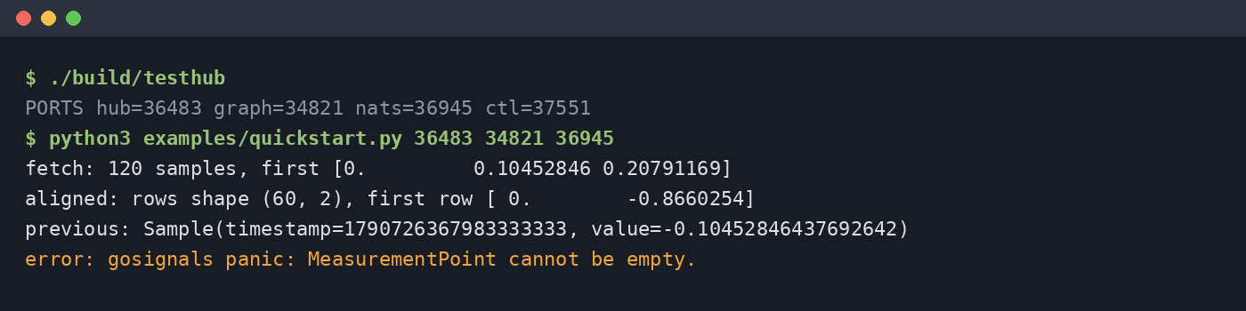
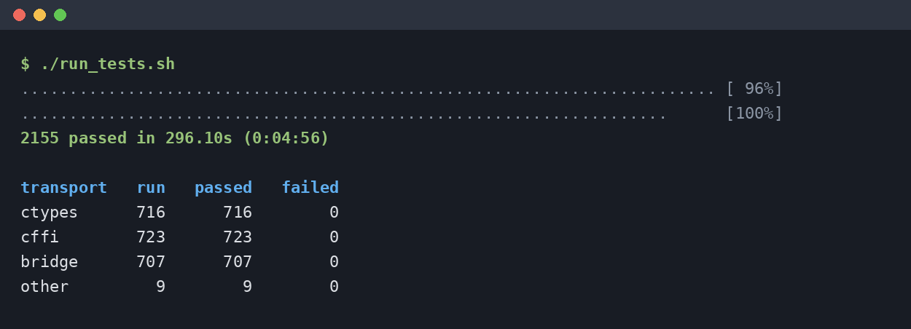
3
Feature 3 Demo | Prototype Running
Quickstart script against the fake Signal Hub, then the full test run
2,155
tests passing
16
sample encodings covered
An engineer's script publishes two phases, fetches history as numpy, reads a time-aligned view, gets the latest sample, and gets a normal Python exception for bad input.
Full suite on September 29. Every transport passes.
0
changes to the Go client
Notes:
Presenter: Lucas Phillips
If recording live, start the fake hub with ./build/testhub and run examples/quickstart.py with the three ports it prints. Walk through each line of output. Then show the test run summary. The last line of the quickstart is a deliberate mistake to show errors come back as Python exceptions.

Slide 9
3
Feature 3 | Performance and Failure Results
About 30 seconds per transport, two runs, float32 at a synthetic 1 MHz rate
Failure testing
Fatal Hub error, panics, fork, Ctrl+C, log floods, killed processes
Only the bridge turned every one into a Python exception
Recommendation
Evaluate C# with Python.NET first in Sprint 5
If Go stays, build on the bridge
Keep the API, fake Hub, and tests either way
Midpoint of the two runs. Latency was about 5 ms at p50 for every transport because the client sends every 10 ms.
Notes:
Presenter: Lucas Phillips
The bridge is actually a bit faster in bulk because it moves whole batches. Per call it is slower, so the API batches data. Latency is the same for all three since it comes from the client. Then give the recommendation, which Joe agreed with on September 28.

Slide 10
3
Feature 3 | Proposed Architecture
Only the transport layer changes between approaches
Python API
What engineers import. numpy in and out, Python exceptions
Design rules that fixed most problems
Go never calls into Python. Data is buffered in Go and Python pulls it in batches.
User callbacks run on a Python thread.
Control info travels as structured messages and samples as raw binary records.
No call blocks more than 250 ms at a time, so Ctrl+C works in about half a second.
Every Go call recovers panics and returns an error.
Transport
gRPC bridge recommended. ctypes and cffi kept for comparison
Go facade
The only code that calls the SEL client. One call per operation, buffers, panic recovery
SignalHub Go client
SEL's client, unchanged
Signal Hub
Real server in deployment, fake Signal Hub in tests
Notes:
Presenter: Lucas Phillips
Go top to bottom through the layers. The important part is that the Go facade is shared by every transport, so the choice of transport does not change the Python API. Then cover the design rules, which came from problems seen in the first prototype.

Slide 11
3
Feature 4 | Documentation and Extensibility
Darron Li
docs/
index.md
getting-started/
installation.md
quickstart.md
user-guide/
signals, publishing, subscribing
history, discovery, time
threads-and-processes, errors
reference/ (generated)
maintainers/
architecture, building
adding-a-function
client-updates, releasing
limitations.md
changelog.md
Tooling
MkDocs with mkdocstrings
NumPy style docstrings
Type hints and .pyi stubs
Examples run as tests
Conventions
Python names, not Go names
Timestamps always int64 ns
Docs ship with the code change
Adding a function
Today about six steps and 40 to 60 lines, mostly mechanical
With the planned generator, one entry in a list and a rebuild
API snapshot and canary tests catch client changes in CI
Notes:
Presenter: Darron Li
Walk through the docs tree and who each part is for. Engineers never need to read Go. Then cover tooling and conventions, and finish with how a future developer adds a function to the wrapper.

Slide 12
3
Testing and Validation
Testing and development process plan, with the suite built for the prototype
Unit
API input, dtypes, rate math
Transport
Each transport on its own
Integration
Python to Go to Hub and back
Validation rule
The SEL client is the source of truth
A test that disagrees with it is wrong, or it found a behavior to design around
Wrapper bugs stay as expected failures until fixed
Interop
All 16 encodings, bit-exact
Concurrency
40 subs and 40 pubs on one client
Failure
Fatal errors, drops, fork, Ctrl+C
Large data
1 million sample round trips
Cross-platform
Linux now, Windows planned
Performance
Throughput, latency, memory
Results so far
2,155 of 2,155 passing
Four wrapper bugs found and fixed
Not yet run on a real Hub or Windows
Workflow for Sprints 5 and 6 is one issue per task with story points, a feature branch, a reviewed pull request, and tests before merge.
Notes:
Presenter: Genevieve Kochel
Cover the test categories and how the fake Signal Hub makes them possible outside SEL. Explain the rule that the SEL client is the source of truth. Then give the results and the gaps, and the workflow going forward.

Slide 13
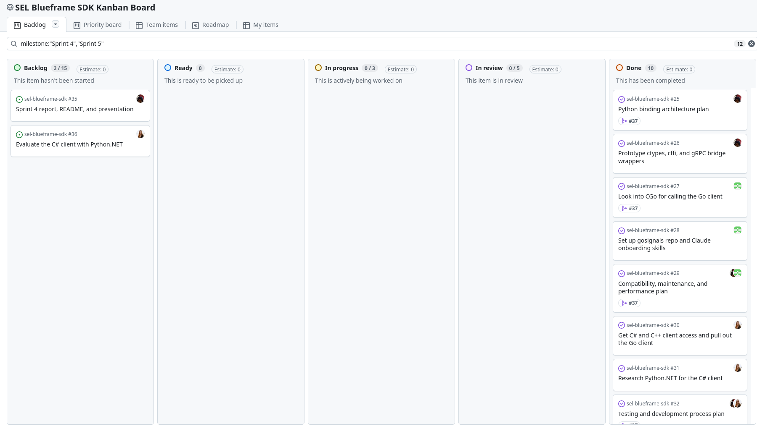
4
Kanban Overview and Team Contributions
Sprint 4 and 5 issues on the project board
Genevieve Kochel #30 #31 #32 #34
Source access, Go client extraction, Python.NET research, meeting coordination, testing plan
Caleb Hansen #27 #28 #29
Private repo, Claude onboarding skills, CGo pitfalls, compatibility plan
Lucas Phillips #25 #26 #32 #35
Bridge prototype, test suite, architecture plan, MoMs, report
Darron Li #33
[PLACEHOLDER, replace with actual contribution] Spearheaded cross-functional alignment on documentation strategy and drove stakeholder synergy across the extensibility roadmap
11 of 12 Sprint 4 issues closed. Each issue has an owner, a story point label, and a comment splitting the points.
Notes:
Presenter: Genevieve Kochel
Show the board filtered to Sprint 4 and 5. Point out the Done column and that the two remaining items are the deck itself and the C# evaluation moved to Sprint 5. Then briefly say what each person contributed.

Slide 14
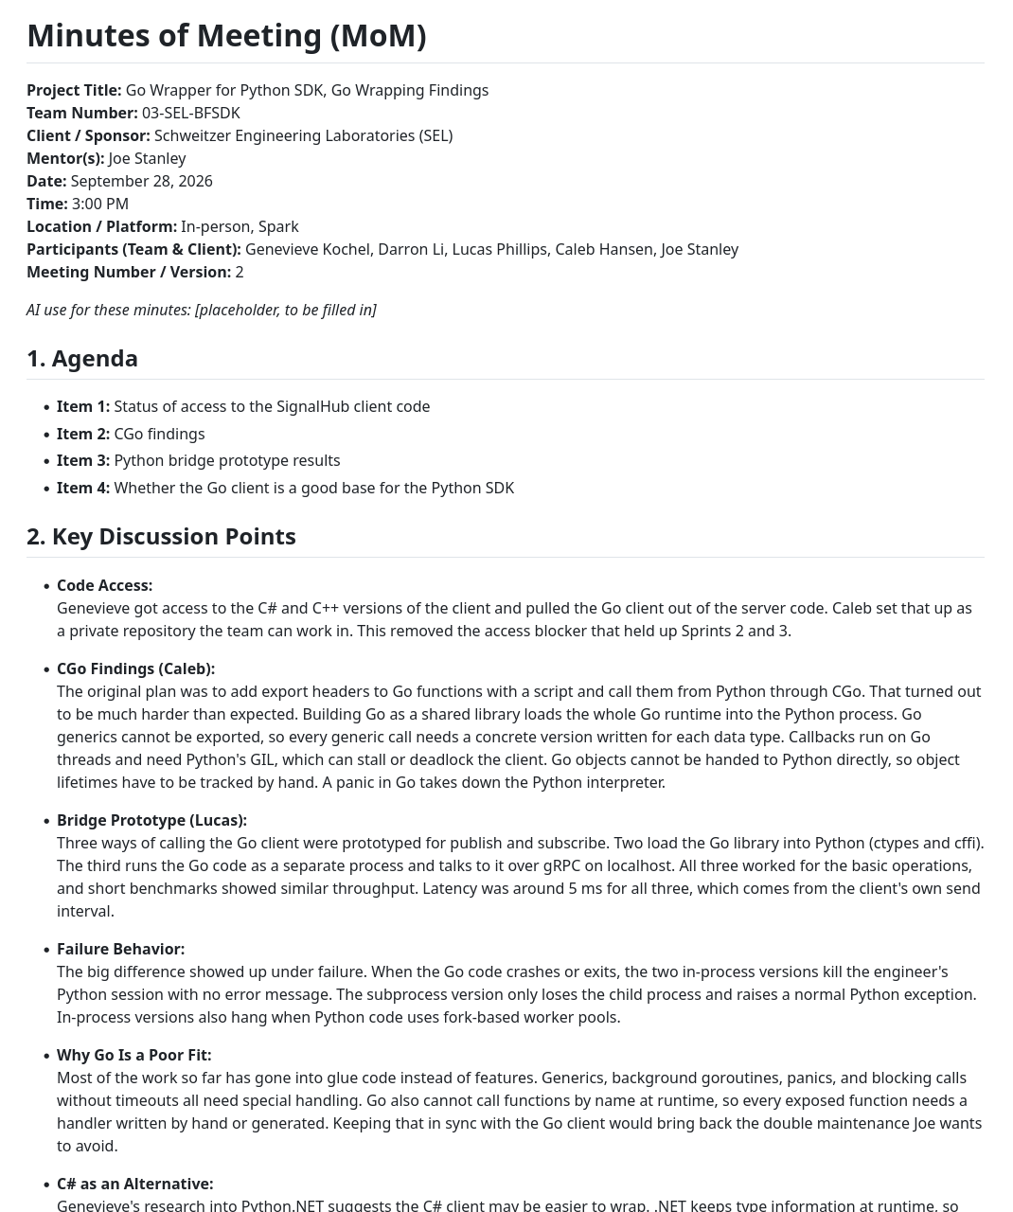
5
Evidence of Client Meetings
MoMs are in Sprints/Sprint_4/MoM on GitHub
September 14 | Semester kickoff
Goal is to find out if a Python wrapper is worth maintaining
No double maintenance, docs are a major deliverable
Python 3.12 baseline, pub/sub is the main use case
AI tools are fine, SEL code stays off the internet
September 28 | Go wrapping findings
CGo pitfalls and the three-transport prototype
In-process approaches are not safe for engineers
Bridge if Go stays, but evaluate C# with Python.NET first
Prototype code stays in the private repo
Notes:
Presenter: Darron Li
Open the MoM folder on GitHub. Go through the two meetings. The first set the goals and constraints for the semester. The second was where the team presented the Go findings and agreed on the direction for Sprint 5.

Slide 15
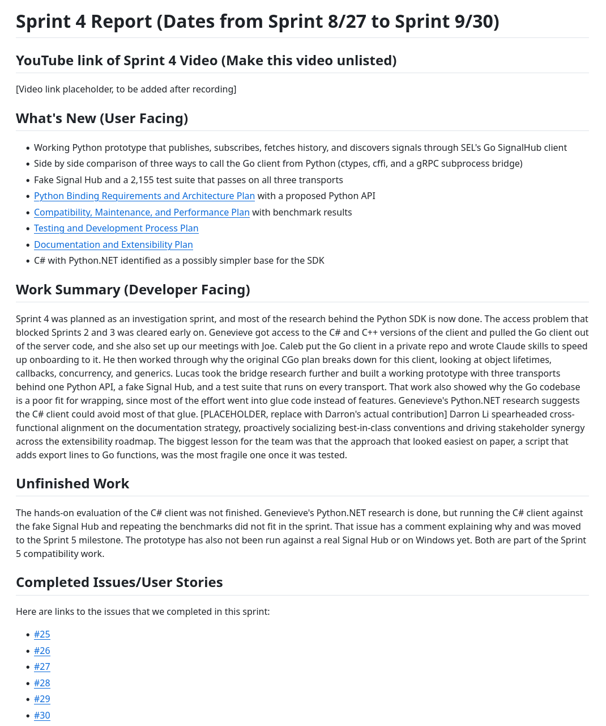
6
Documentation of Report
What was added to the repo this sprint
1
Sprint 4 report
Sprints/Sprint_4/Sprint_Report.md, following the course template
2
Four planning documents
docs/Sprint4, one per Sprint 4 deliverable in the project plan
3
Two MoMs
Sprints/Sprint_4/MoM for September 14 and 28
4
README update
Rewritten to the README template with setup, usage, and known problems
5
Prototype code
Private gosignals repo, pysdk-research branch, since the client is SEL Confidential
Notes:
Presenter: Lucas Phillips
Scroll through the Sprint 4 report on GitHub section by section. Then show the docs/Sprint4 folder and the README. Mention that the prototype code is not in the public repo on purpose because the client is SEL Confidential.

Slide 16
7
Responsible Use of AI
Placeholders to be filled in by the team
AI usage and impact
[PLACEHOLDER] Which tools each member used
[PLACEHOLDER] What they were used for (code, docs, research, meeting notes)
[PLACEHOLDER] What improved as a result
Limitations and accountability
[PLACEHOLDER] Errors or limits seen in AI output
[PLACEHOLDER] How AI output was checked and corrected
[PLACEHOLDER] Confidentiality handling for SEL code
All final decisions and deliverables are the team's responsibility
Notes:
Presenter: Caleb Hansen
Placeholder. Fill in once the team has written up its AI usage.

Slide 17
8
Sprint Achievements and Challenges
Achievements
Access to the client code after two sprints of waiting
Three working transports behind one Python API
2,155 passing tests and a fake Signal Hub we can keep
All four planned documents finished
Challenges and solutions
The CGo export plan did not work. It was replaced with a shared facade and tested against two other transports.
The client is SEL Confidential. Public docs are sanitized and code stays in a private repo.
No real Signal Hub outside SEL. A fake one was built for testing.
Progress from Sprint 3
Sprint 3 wrapped our own COMTRADE code with CGo and subprocess
Sprint 4 repeated that comparison on the real client, which is much harder to wrap
The access blocker from Sprints 2 and 3 is gone
Notes:
Presenter: Genevieve Kochel
Go through achievements, then the challenges and how each was handled. Finish by connecting back to Sprint 3, where the same comparison was done on simpler code.

Slide 18
9
Next Steps and Sprint Retrospective
Sprint 5 plan
Evaluate the C# client with Python.NET in week one (#36)
Build the Python bindings on the chosen base
Automated test harness in CI
Cross-platform checks on Linux and Windows
First user docs and examples
Retrospective
Went well
Access came through and unblocked the team
Test results answered Joe's question
To improve
Test risky assumptions like CGo earlier
Push prototype work as it happens
Acting on client feedback
No double maintenance drove the wrap-not-port design
Pub/sub was built and tested first
Python 3.12 is the tested baseline
SEL code kept off the public repo
Notes:
Presenter: Darron Li
Outline the Sprint 5 plan, starting with the C# evaluation. Then cover what went well and what to improve. End with the specific things done because of Joe's feedback.

Slide 19
Conclusion
Wrapping the Go client works, but only safely out of process, and most of the effort is glue code.
The bridge prototype, test suite, and plans are ready to carry into Sprint 5.
Next up is the C# check, then building the bindings on whichever base holds up.
Thank you to Joe Stanley and SEL, and to the course staff.
Questions and feedback are welcome.
10
Notes:
Presenter: Lucas Phillips
Recap the three takeaways. Thank Joe, SEL, and the course staff, and invite questions.

